Slide 1
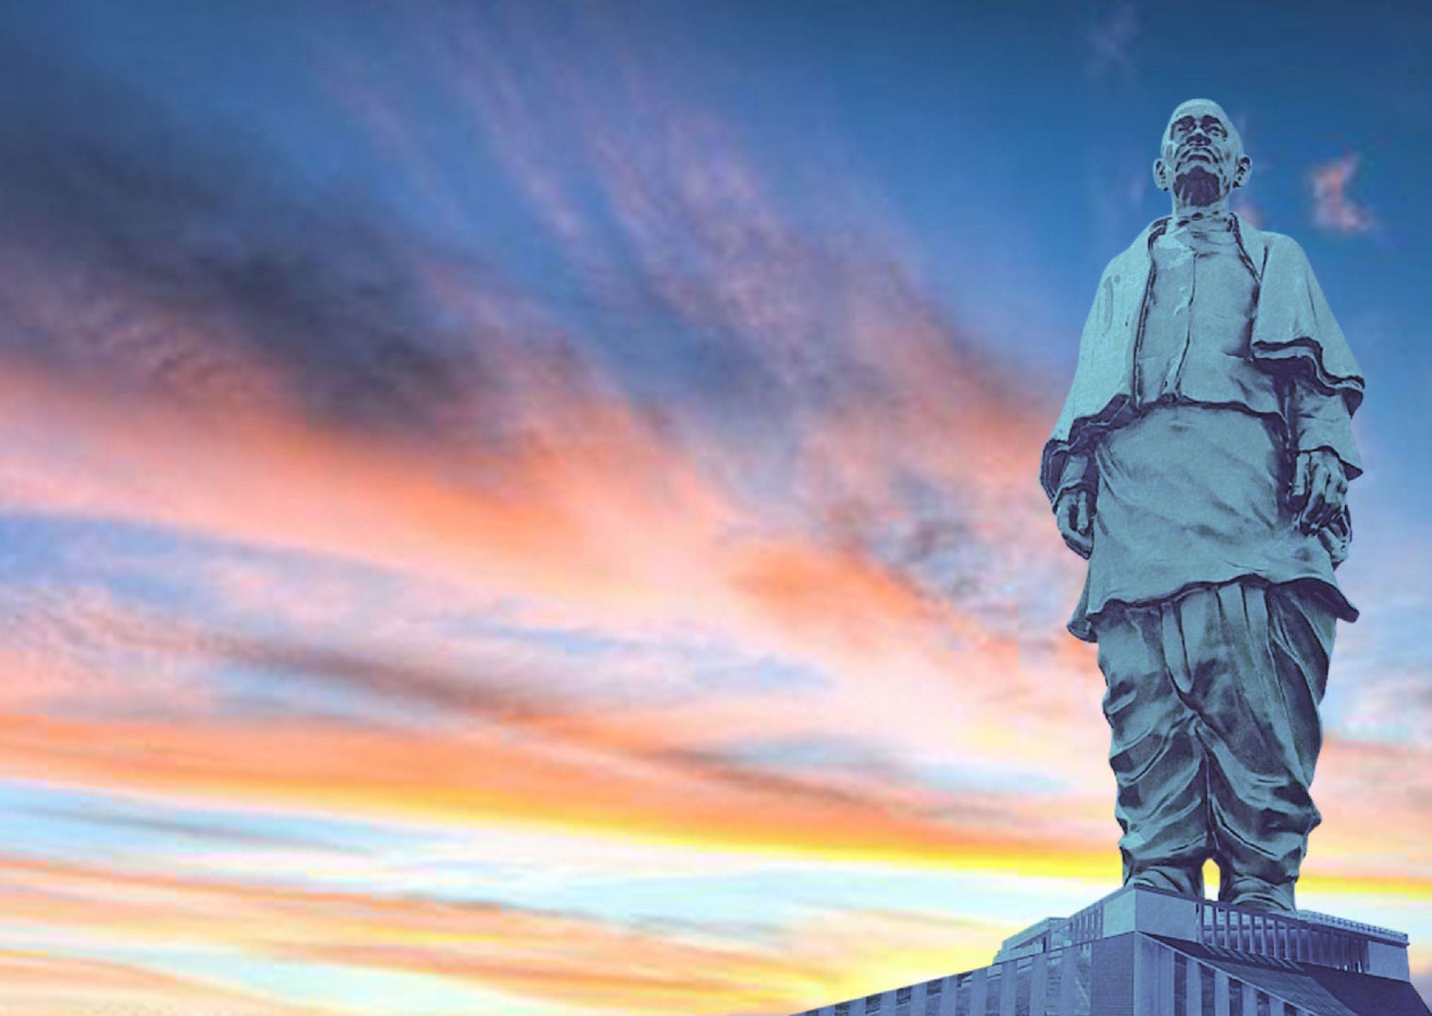
Statue of Unity

Slide 2
What were the reasons to build this massive structure
Respect from fellow countries
It’s a matter of pride that we have the tallest statue in the world
It’ll create more jobs
It’ll attract more tourists
It’s a tribute to the Iron man of India

Slide 3
BUT this is what our government says !

Slide 4
And this is what the analysis says !

Slide 5
I will discuss 5 main aspects of this project
Economical aspect
Cultural aspect
Social aspect
Political aspect
Tourism aspect

Slide 6

Economical Aspect

Slide 7
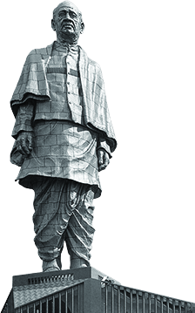
Economics of the statue
Cost - 400 Million $ (3000 crore Rs)
Took 57 months to plan, construct and hand over to the government.
Amenities apart from the statue –
Theme based gardens
Infotainment
Eco-tourism sector
Adventure sports
Night tourism
Shopping
Eating points
Height – 182m
So all the amenities and the maintenance work does creates jobs but was it necessary to invest 3000 crore to offer 100 jobs ?

Slide 8
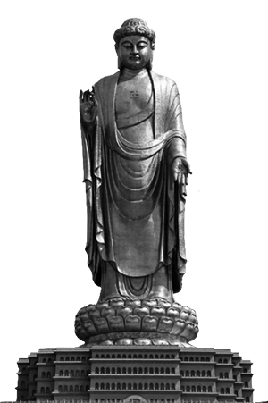
PRICE COMPARISSION
400 Million $ (3000 crore Rs)
55 Million $ (408 crore Rs)
Height – 182m
Height – 128m

Slide 9
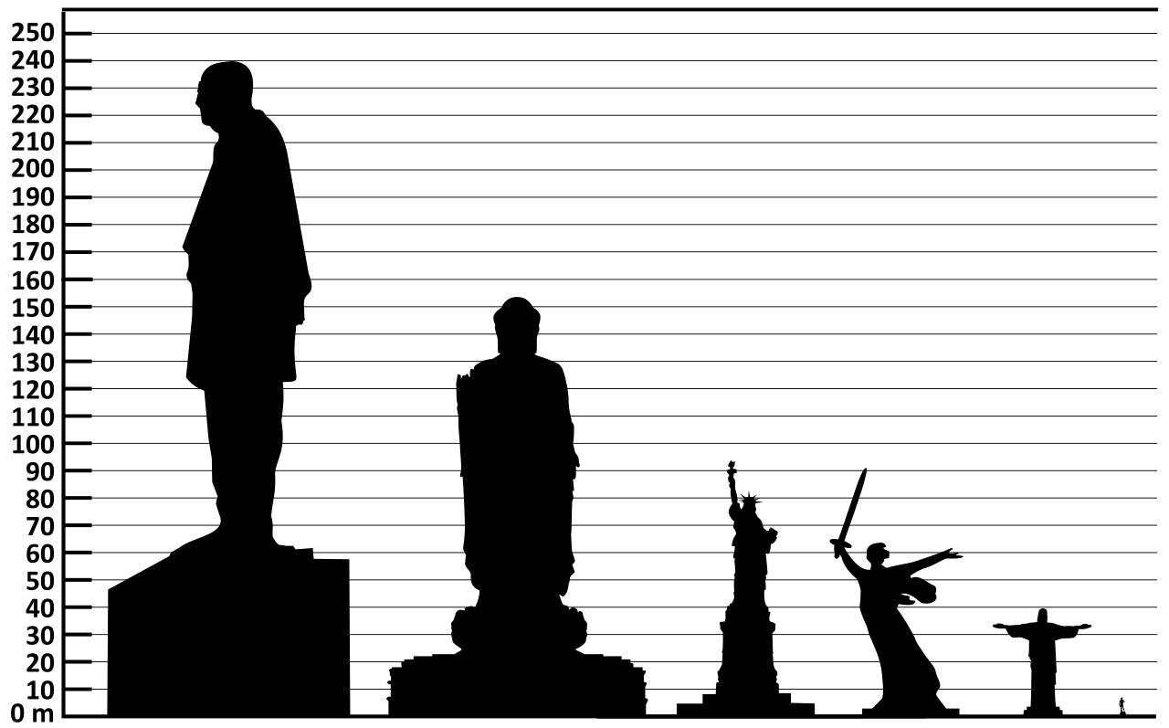
This distance costed us around 345 million $

Slide 10
What is our benefit from the project ?
Visibly nothing !
Because it contributed to China’s economy more than it did to Indian economy as it was partially built there and on top of that it was our money! It was the money we paid in form of taxes.
And this is what the distribution looks like of what we pay as tax payers

Slide 11

This represents our population every character here is 10 % of India’s population

Slide 12

The top 10% of the Indian population holds 77% of the total national wealth. 73% of the wealth generated in 2017 went to the richest 1%

Slide 13
67 million Indians who comprise the poorest half of the population saw only a 1% increase in their wealth.

Slide 14
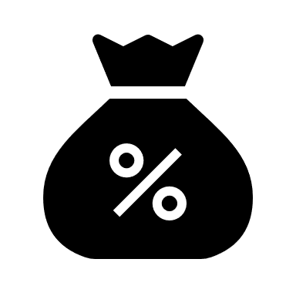
TAX PAYING DISTRIBUTION
10%
40%
50%
Earn bellow 2.5 lakh per year
2.5 lakh – 10 lakh
Earn more than 10 lakh

Slide 15
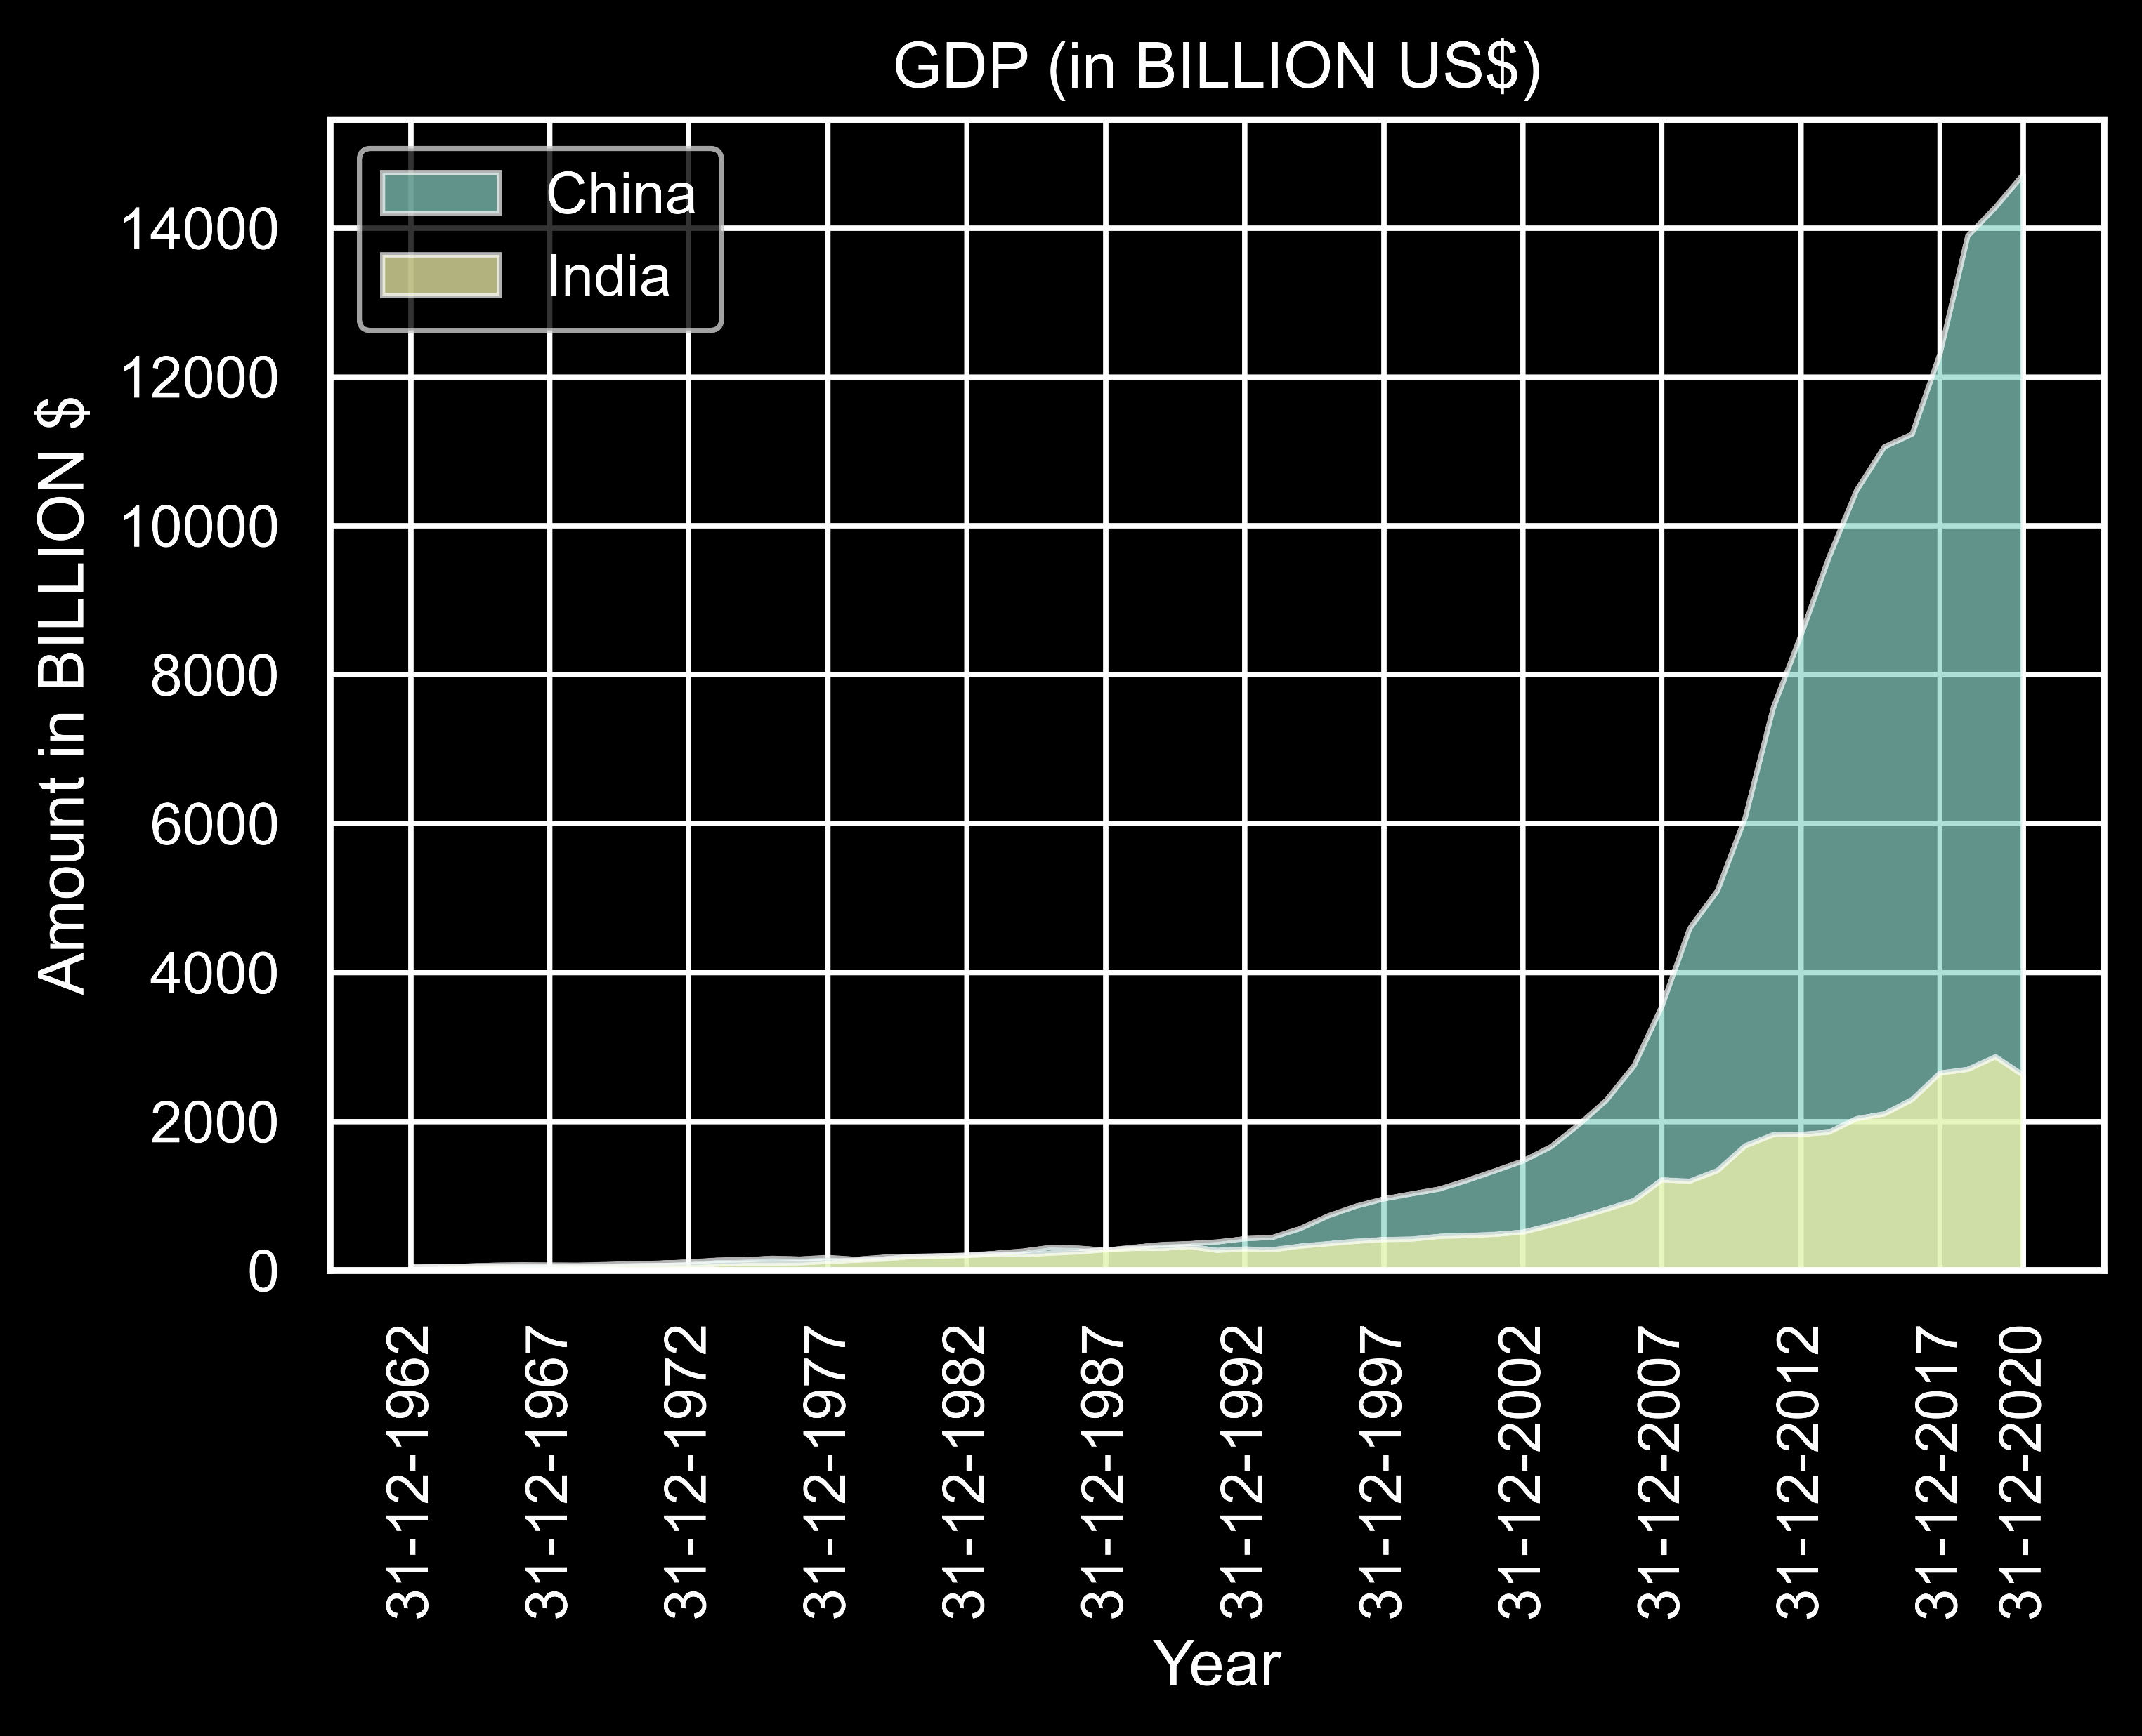
China’s GDP is almost 5 times ours and we are using 10-15 times the money what China spends on structures.
In 1990’s India’s GDP and China’s GDP was exactly the same (2 trillion $) and now almost 30 years later China is way ahead of India.

Slide 16
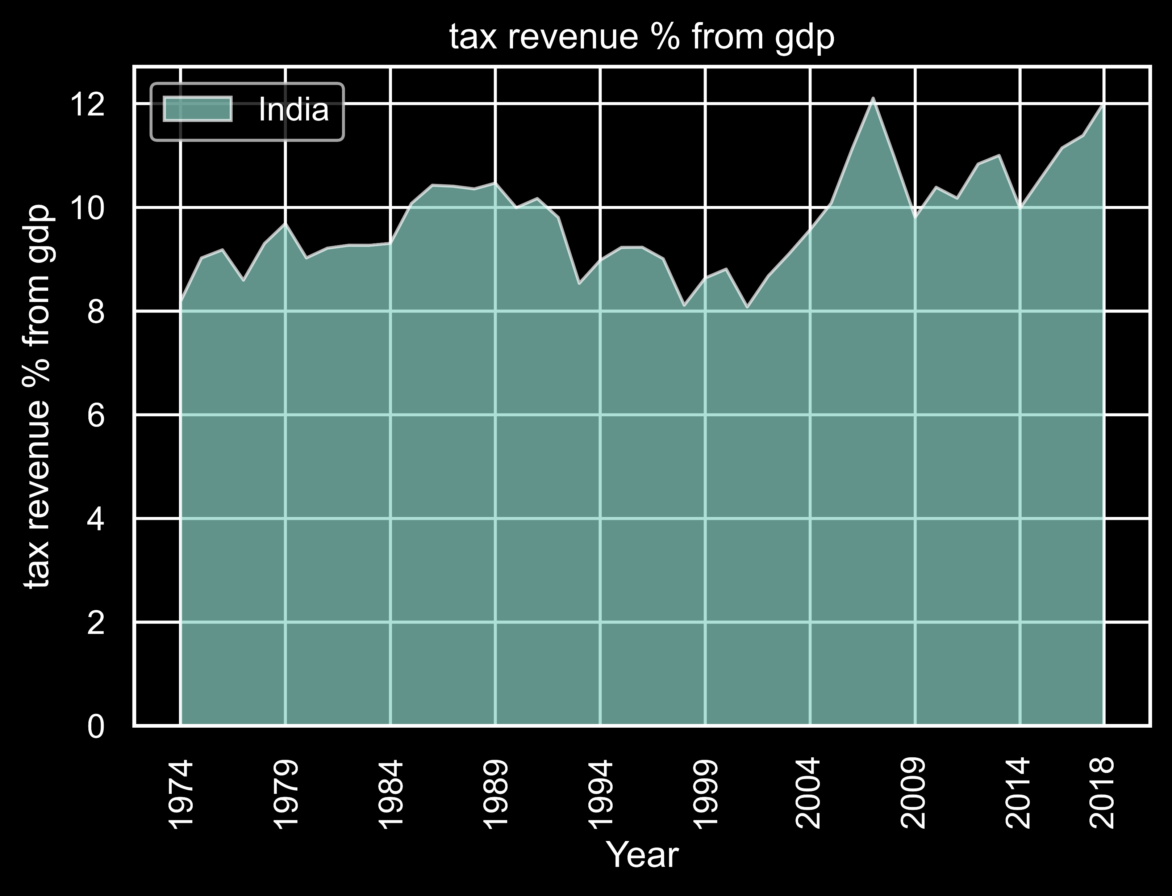
From this we can conclude that 12 % of our GDP is 264 billion $ from which just the construction cost of the structure was 400 million that is .15 % of our GDP

Slide 17
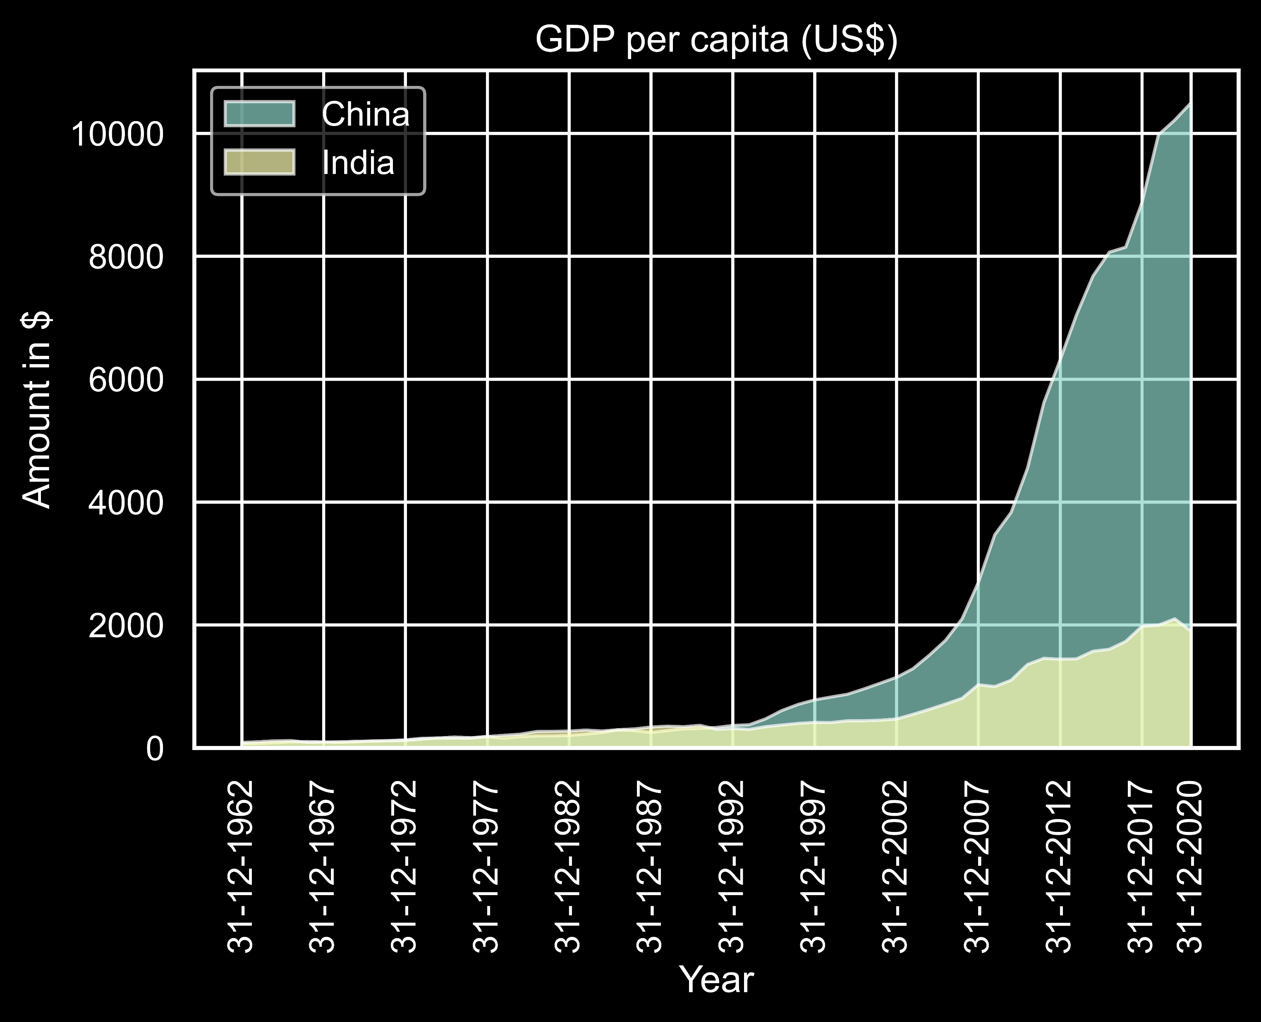
On average a person in India earns just 2000 $ that is 1,48,000 Rs but on the other side an average person in China earns 11000 $ that is 8,20,000 Rs

Slide 18
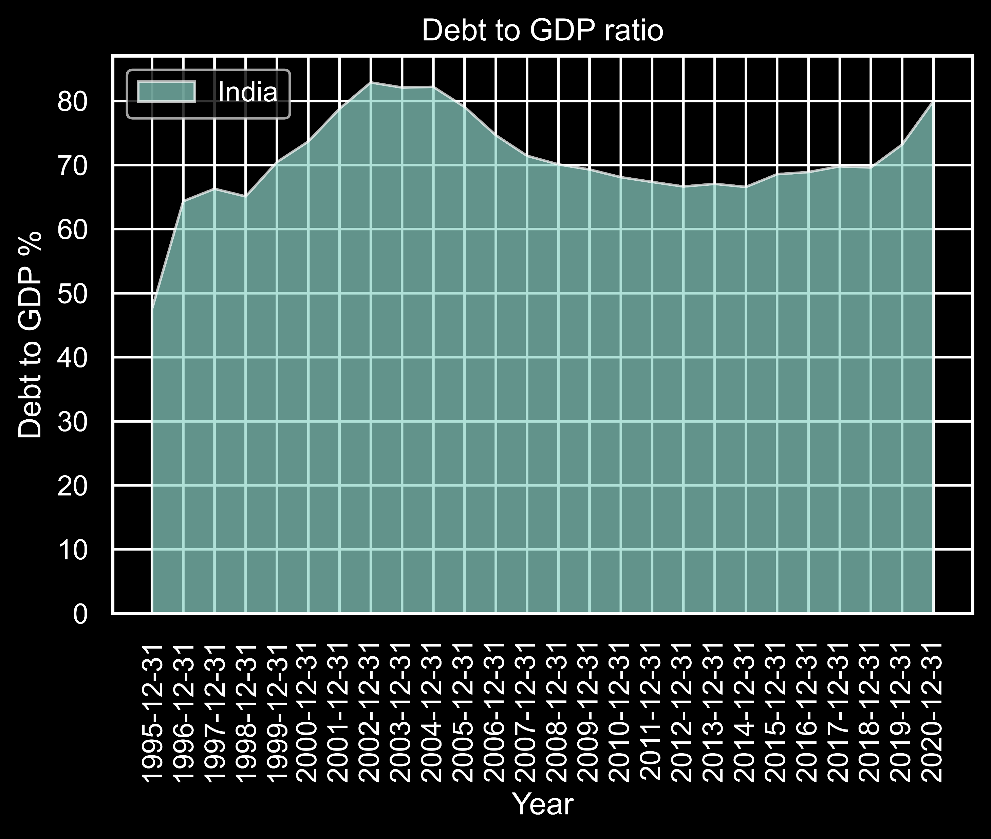
And rather then building a statue we could have just try to pay of our debts

Slide 19

But maybe the return of investment is HIGH enough ?

Slide 20
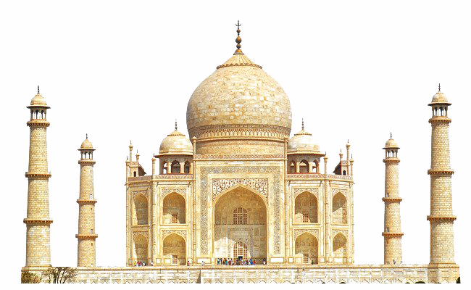
Here is the comparison
Inaugurated in 2018, maximum ticket that is to visit the deck in 350 Rs
2018-2019 data - 27 lakh people visited the place and revenue for the first year was 80 crores.
Return of investment was 2.7% that is less then the inflation rate that is 7% and a savings account gives around 6% return on investment
Most visited monument of India around 8 million yearly visitors
25 crore yearly revenue and this is after so decades of opening it
so from this we can conclude that the visitors for the statue of unity will only decrease with time

Slide 21
But that’s not enough there’s more to it !
Advertisement costed around 2.6 crores as they advertised all over India right from train stations in Kerela to metro stations in Delhi and that is just the data from Nov 2018 to Jan 2019.
Moreover maintenance costs a lot as in the first year itself the deck got flooded.
And for some reason they constructed a dinosaur 30ft tall worth Rs 2 crore just beside the statue of unity and it broke in the first week itself.

Slide 22
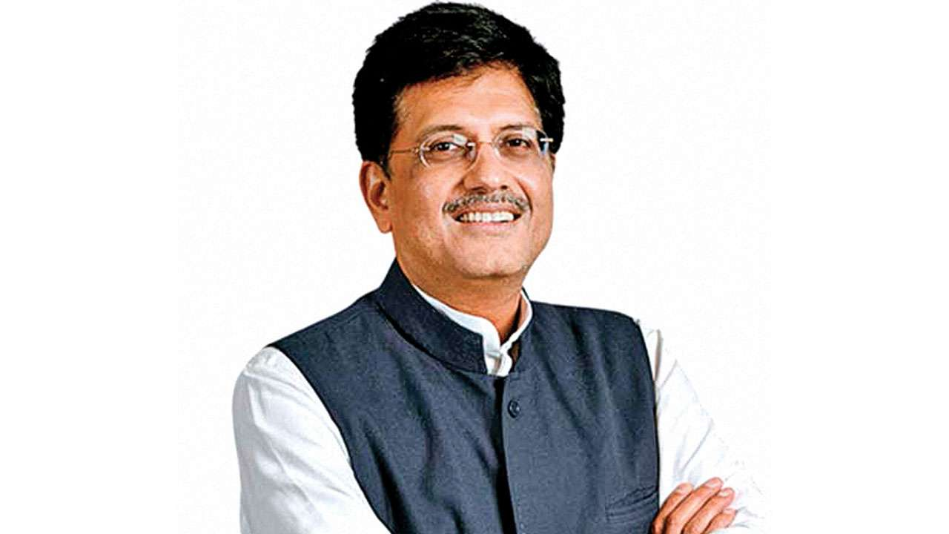
But our government still believes that there is a lot of profit behind the structure !
This guy said that in 4-5 years statue will generate 1 lakh crore every year
But if we want revenue of 1 lakh crore every year and there is 27 lakh yearly visitors (just for the first year but let us consider that it attracts 27 lakh visitors every year) then
1 lakh crore / 27 lakh = 3.7 lakh Rs
So 3.7 lakh Rs should be the ticket for every person according to Piyush Goyal
Piyush Goyal

Slide 23


Slide 24

Cultural Aspect

Slide 25
Cultural Aspect
There are 3600+ monuments under the Archaeological Survey of India and a lot of them don’t have basic amenities like washrooms.
And just 116 has entry tickets.
Instead of building statues with Cultural Reasons we could just have improved other 3400+ monuments and impose entry tickets in them that is better economical as well as cultural and with this we can preserve our history.

Slide 26

Social Aspect

Slide 27
Social Aspect
We just saw that 50% of the tax revenue is generated from economically weaker sections and most of the people in the weaker sections come from rural areas.
While constructing the statue 72 villages were force to leave the area and those were the people who contributed the most in the making of the statue !
People contributing the most had to suffer the most !

Slide 28

Political Aspect

Slide 29
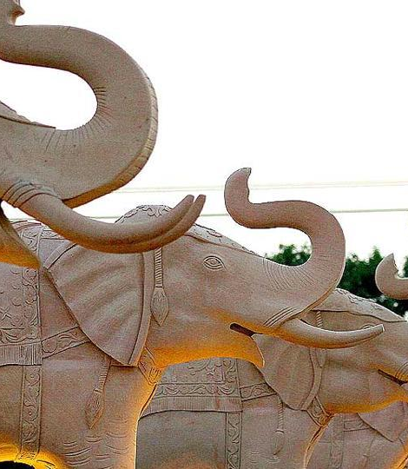
Statue of unity is not the only statue build for political reasons ! This is Mayawati Elephants build for the exact same reason

Slide 30
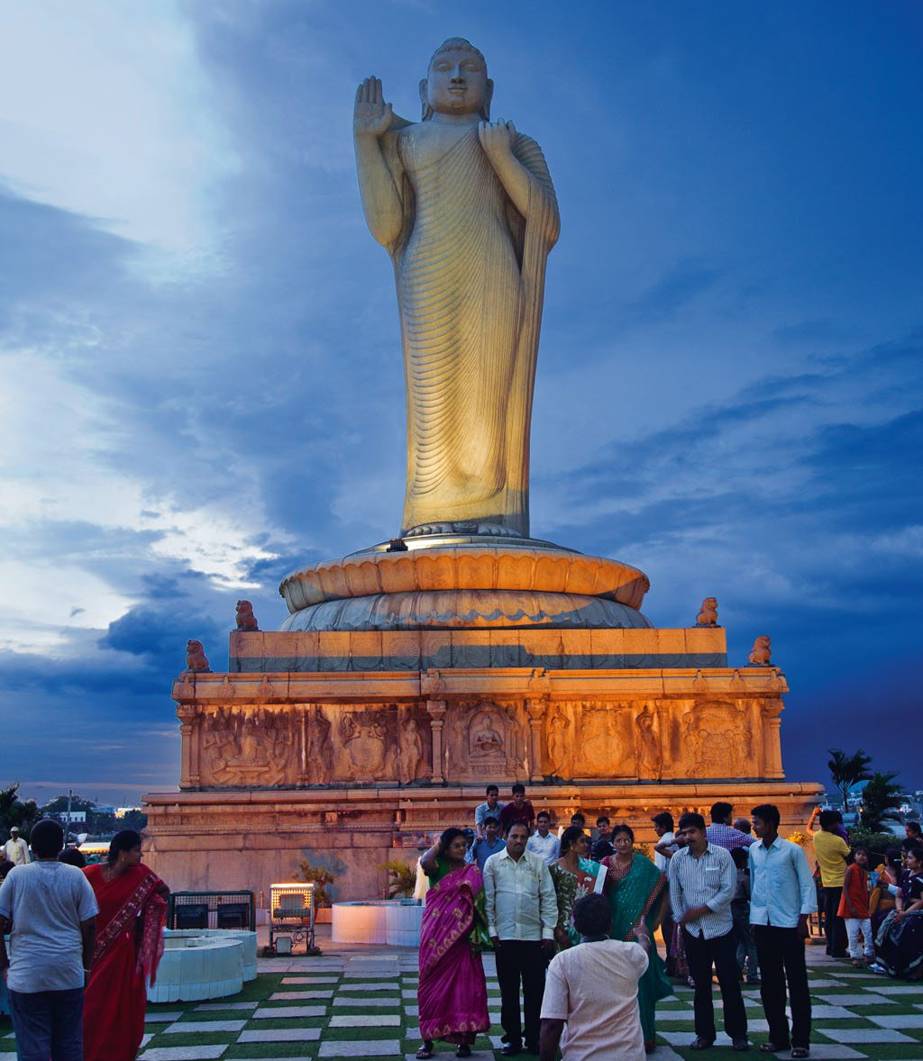
And it’s more than you can think of this is the Hussain Sagar lake statue

Slide 31
Political Aspect
The guy who did the inauguration was once a part of RSS and Sardar was against RSS from the very starting.
And moreover Sardar would never have approved of such projects.
POLITICS IS FOR LOSERS !

Slide 32

Tourism Aspect

Slide 33
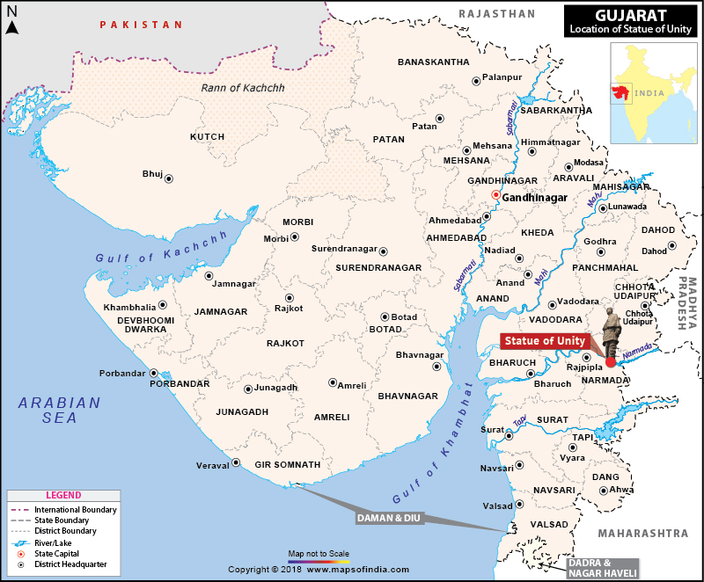
I don’t think it’ll ever be as successful as other tourist destinations
As it is not situated in a major city and is 200 Kms from Ahmedabad, 90 Kms from Vadodara and 155 Kms from Surat

Slide 34
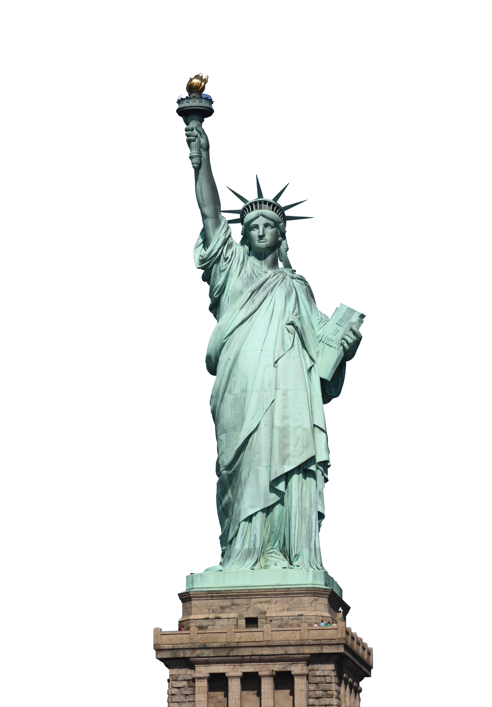
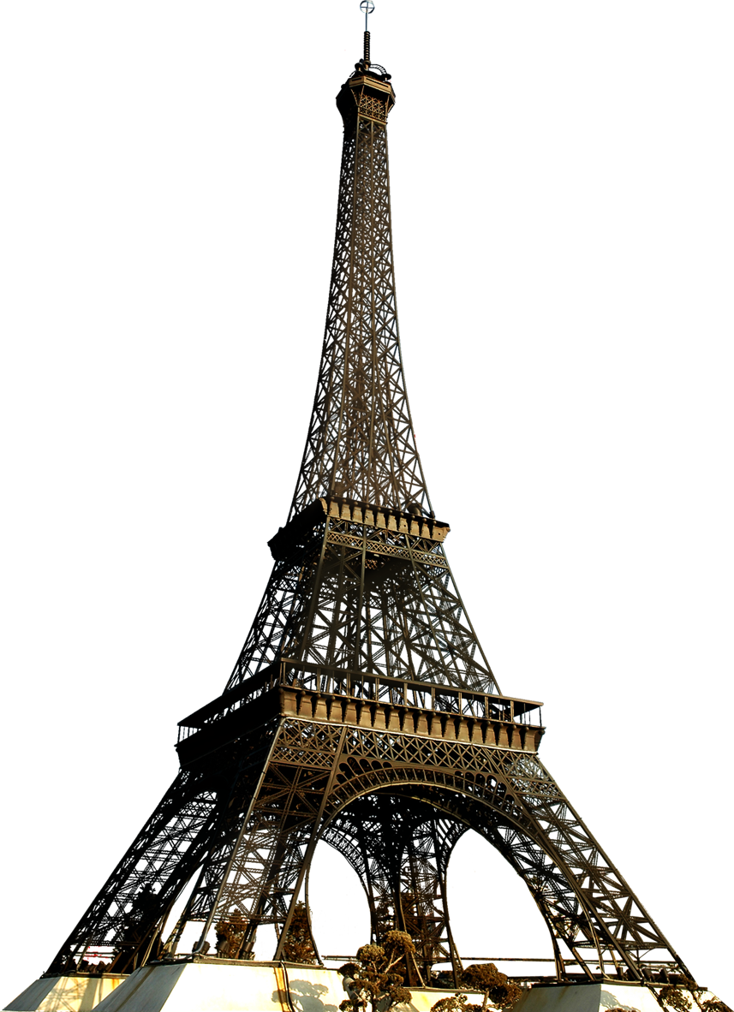
And why is that ?
All the Top rated tourist attractions are situated or are around major cities.
Paris, France
New York city, USA

Slide 35
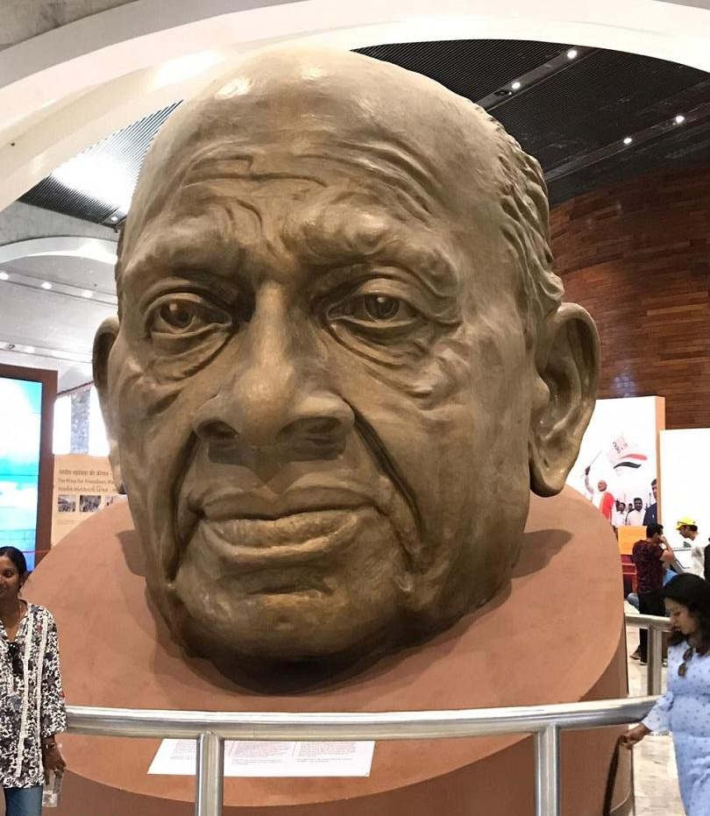
Tourism Aspect
There is nothing unique in the statue itself apart from being the tallest in the world.
Its not that attractive.
And on top of that Spring temple buddha is not even in the top 10 locations to visit in China.

Slide 36

We could have used that money somewhere else !

Slide 37
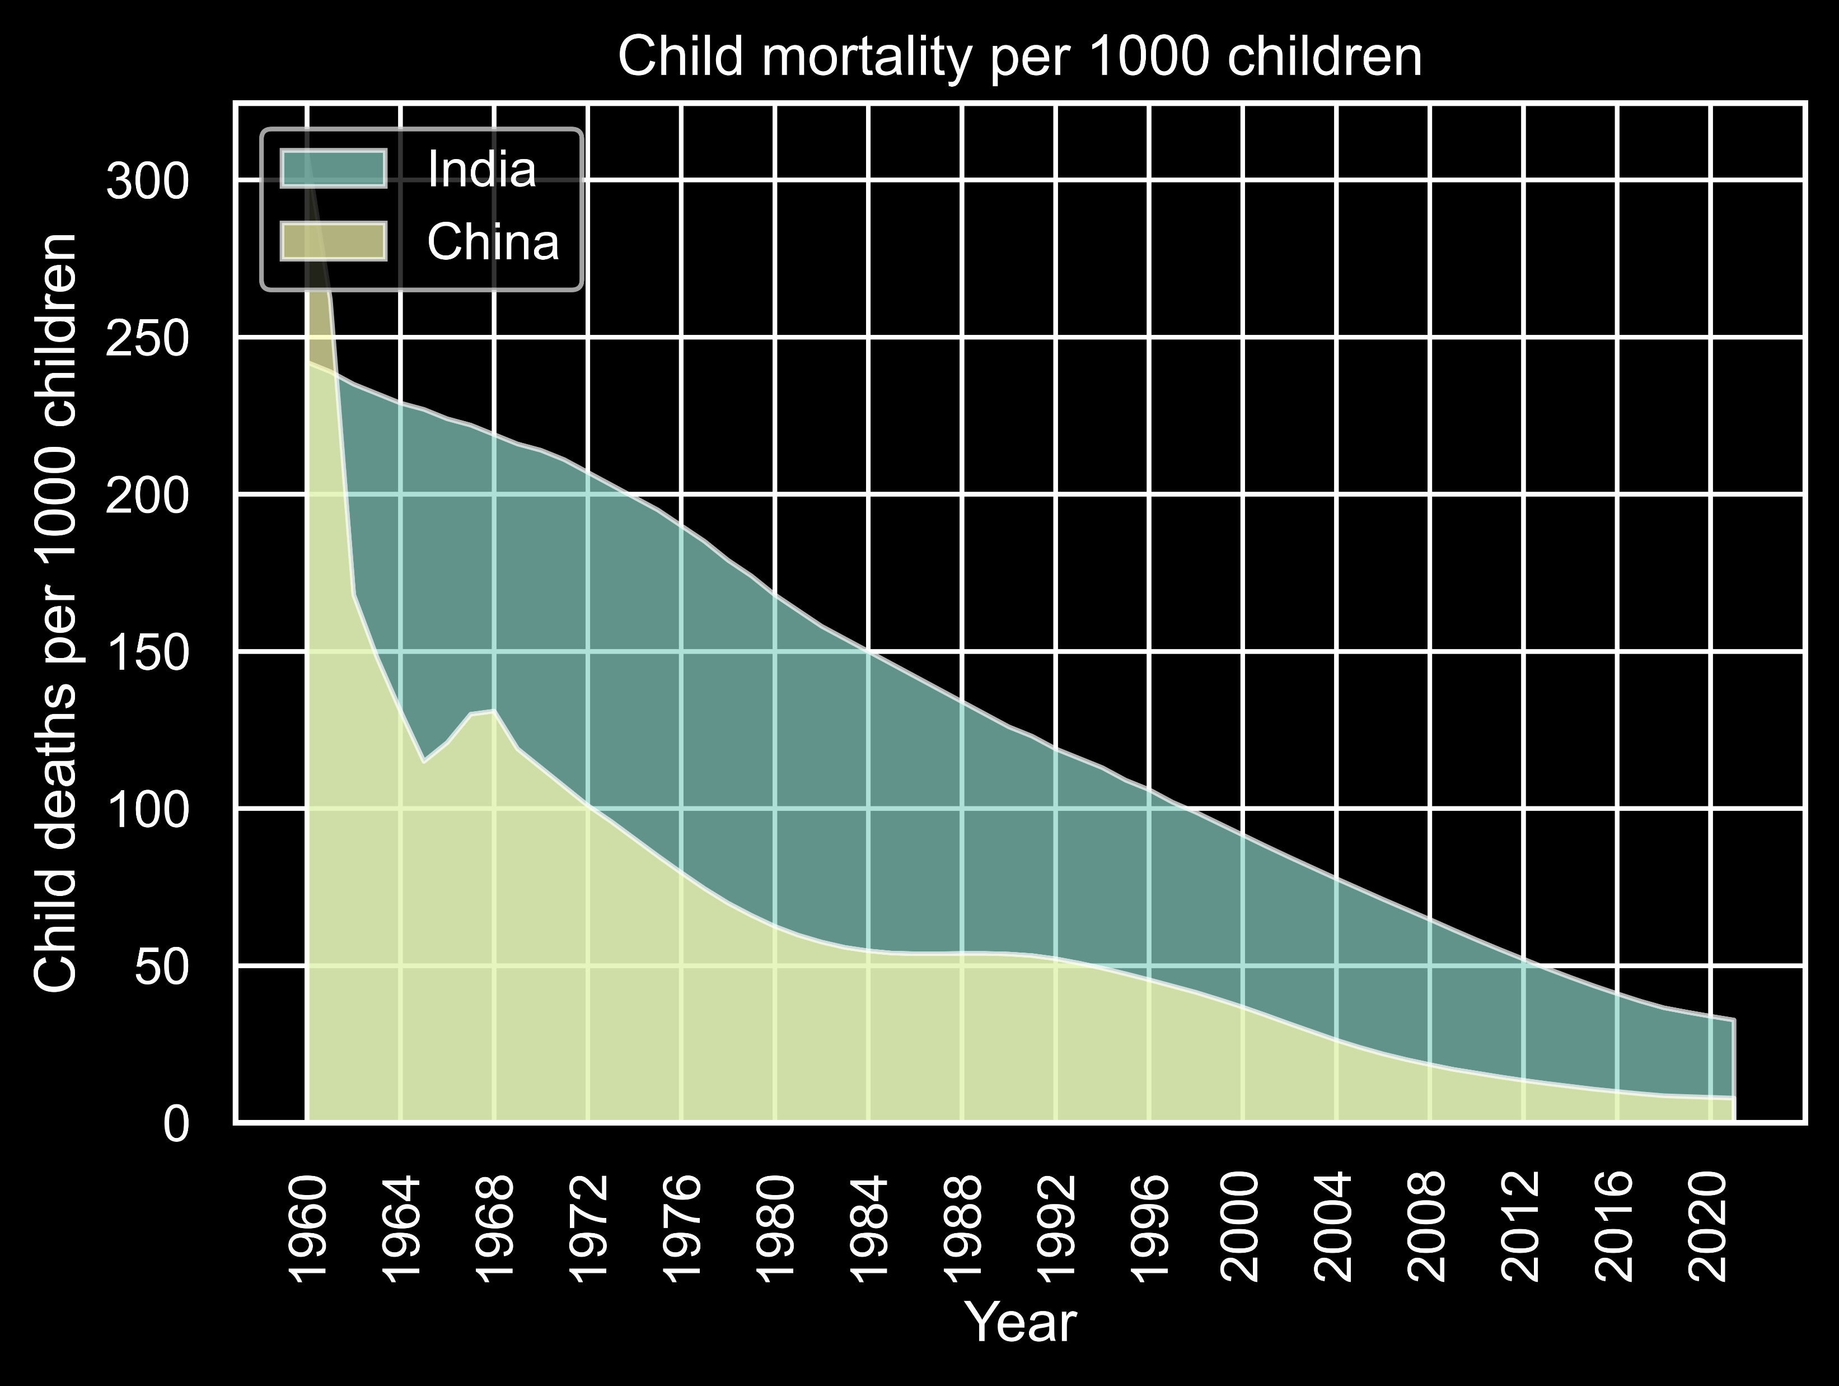
We could have just invested that money into our health care of vaccines for children
From the graph it is obvious how China invested in there healthcare in 1969s

Slide 38
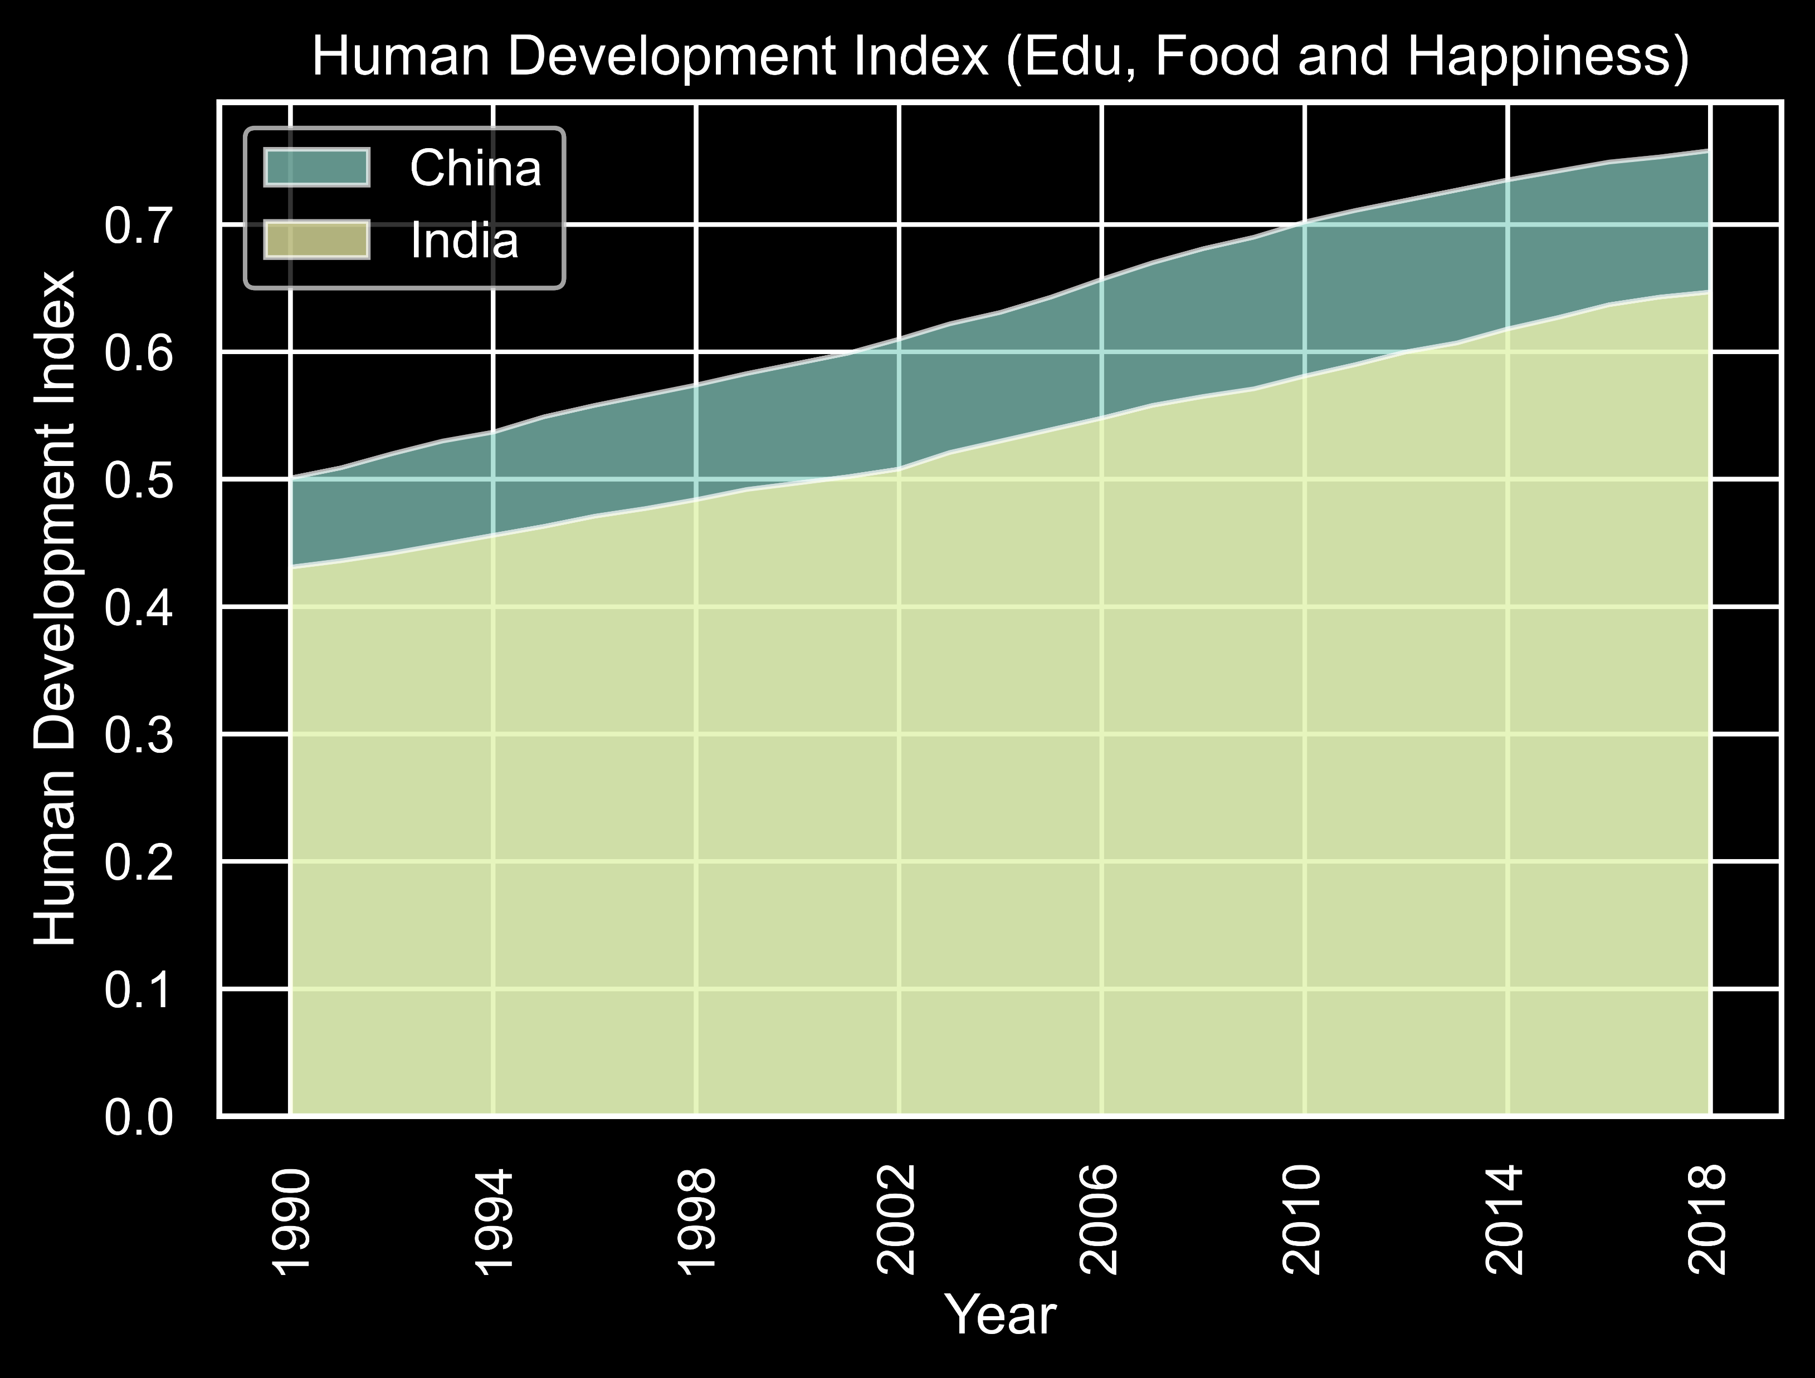
We could have invested that money into Food or Happiness of our population

Slide 39
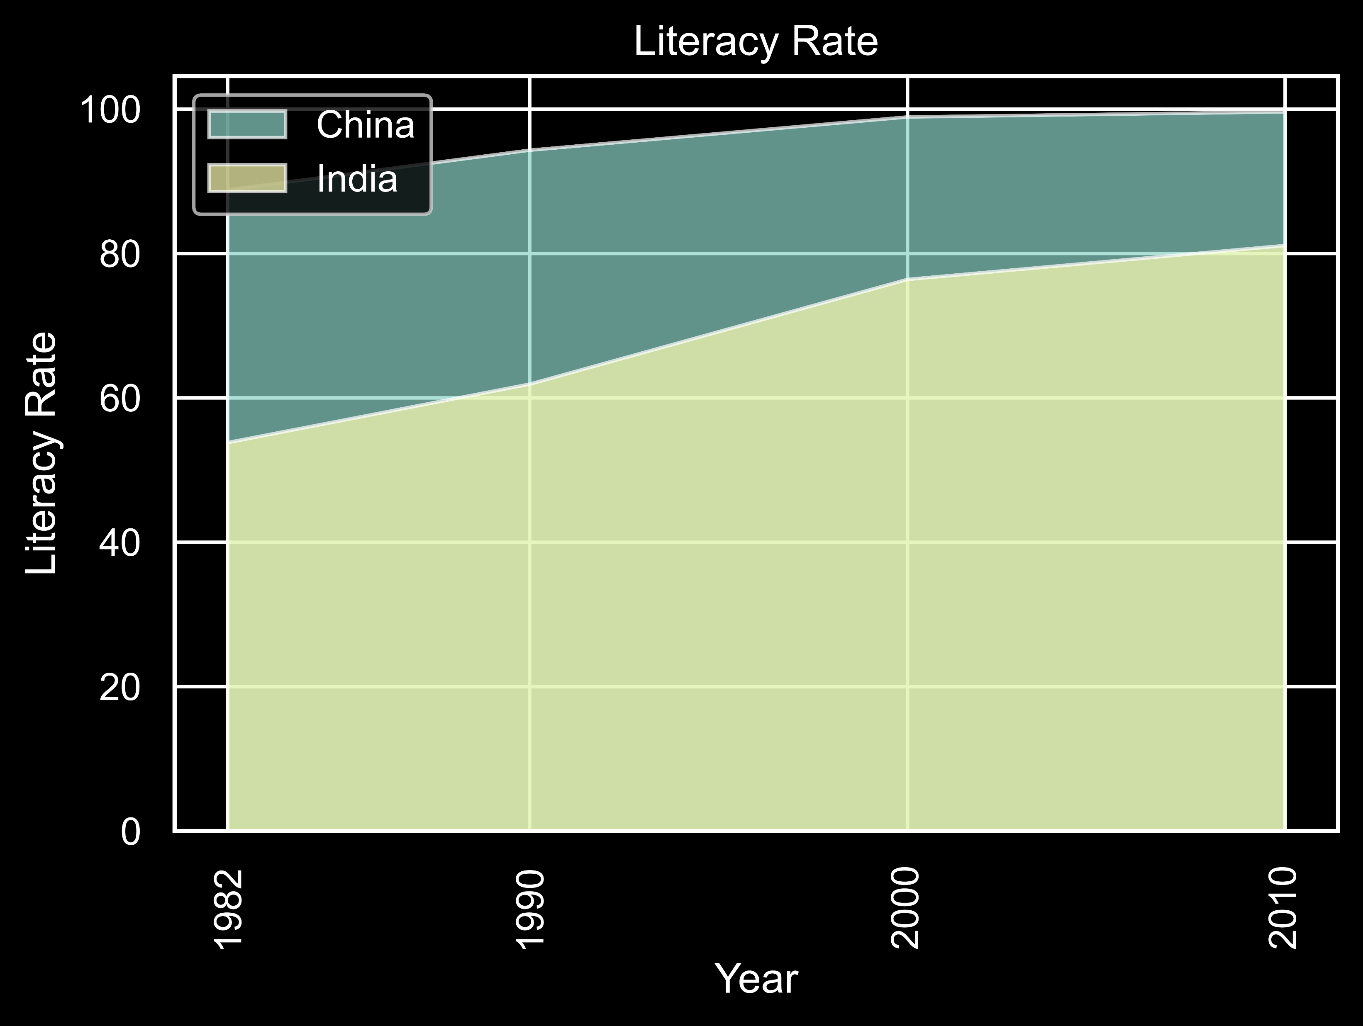
Or better we could just have made schools or made Tuition as low as possible

Slide 40
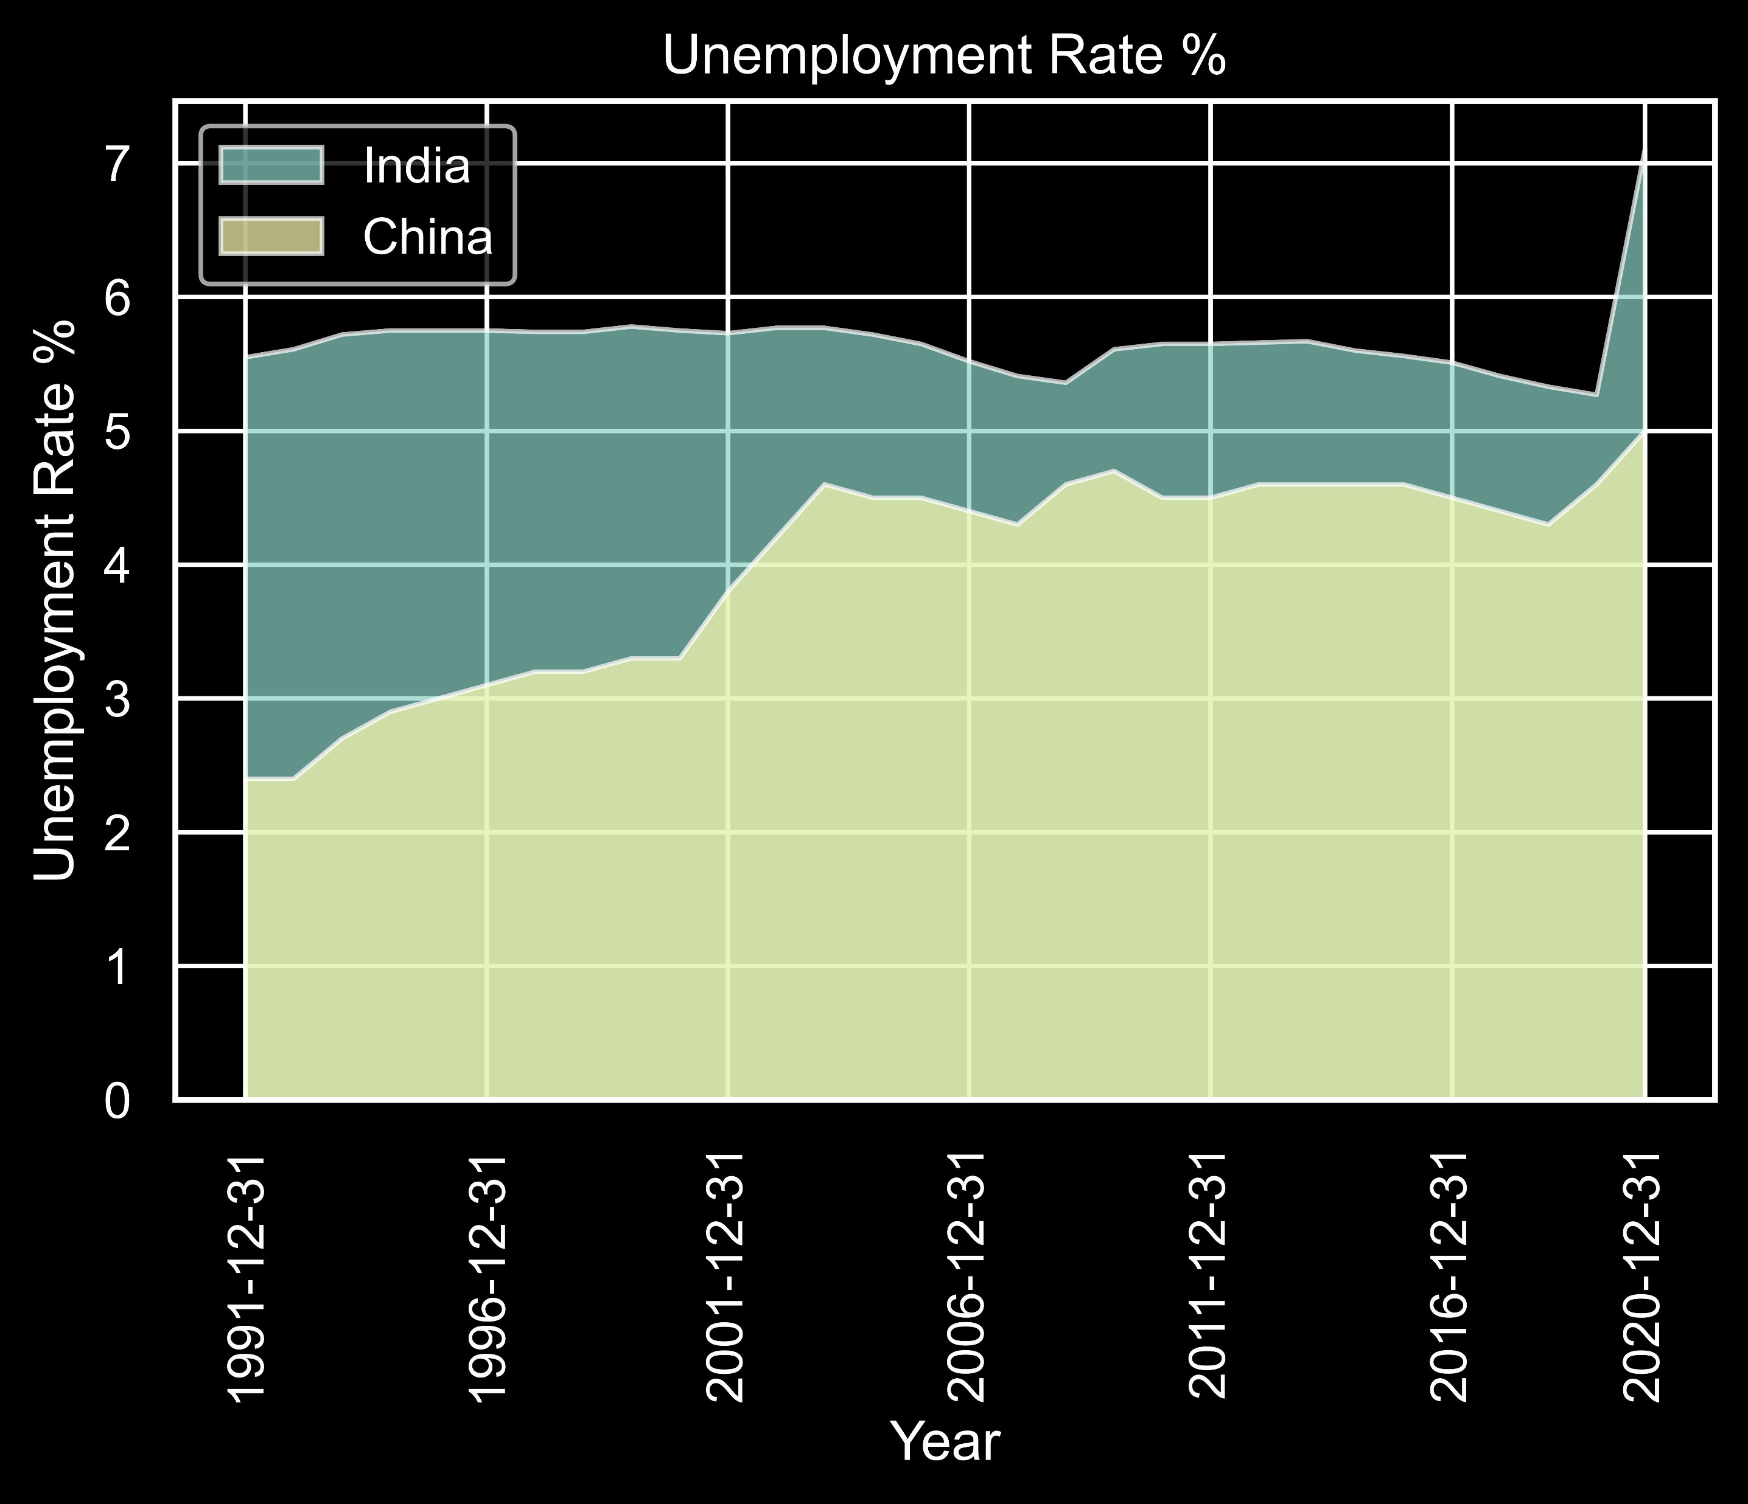
Rather than creating jobs in the tourism sector we could have made our service sector more stronger because 50% of our GDP comes from the service sector

Slide 41
All these investment won’t generate any return on investment in terms of money but this investment can make India stronger internally rather than showing our unity with a statue.

